Slide 2
3 years ago…
I founded the nonprofit sheCodesNow that empowers women by giving them free programming workshops in Seattle and Detroit.
We developed a 12-part series open-source curriculum; github.com/She-Codes-Now
I formed a team of 100+ volunteers that provide monthly coding workshops.
I formed a 4 woman leadership team: PM, Event Planner, Marketing & Curriculum Director.
We built a dev community of 1,800+ women in tech.
To further grow our community, we've managed booths and spoken at multiple tech conferences such as:
Microsoft PyData
Amazon AWS Diversity Panel
SeattleJS
ACT-W Seattle
WiT Regatta
Etc…

Slide 3
What do you think Imposter Syndrome is, anyway?

Slide 4
Steep Learning Curve ≠ Less Functionality
Sometimes we assume that a steep learning curve is an indicator that we are not talented or smart enough to work in a specific area. This phenomenon is commonly referred to as “imposter syndrome.”

Slide 5
Let’s learn how to RETRAIN our brains to overcome self-doubt!

Slide 6
Realize Engage Treat Reread Accept Identify Never
Realize that most people are self-absorbed and don’t really spend that much time thinking about us and our behaviors.

Slide 7
Realize Engage Treat Reread Accept Identify Never
Engage your energies toward helping others first.

Slide 8
That said…Beware of Tech Burnout!
New research shows that burnout is caused by a mismatch between a person's unconscious needs and the opportunities and demands at the workplace. ... Burnout is a state of physical, emotional, and mental exhaustion from work, which results in a lack of motivation, low efficiency, and a helpless feeling.
ORIGINAL RESEARCH ARTICLE
Front. Psychol., 11 August 2016 | https://www.frontiersin.org/articles/10.3389/fpsyg.2016.01153/full
Veronika Brandstätter & Veronika Job ¹
Beate Schulze ²
¹ Department of Psychology, University of Zurich, Zurich, Switzerland
² Institute of Social Medicine, Occupational Health and Public Health, University of Leipzig, Leipzig, Germany

Slide 9
How do I know if I’m burned out?
Exhaustion
Inefficacy
Cynicism

Slide 10
Realize Engage Treat Reread Accept Identify Never
Treat Imposter Syndrome the same way you would treat a controlling partner in an unhealthy relationship. Don’t let it tell you what to do!

Slide 11

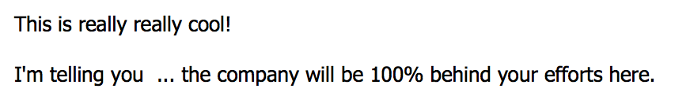
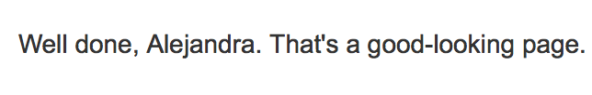

Realize Engage Treat Reread Accept Identify Never
Reread nice notes that people have written you.

Slide 12
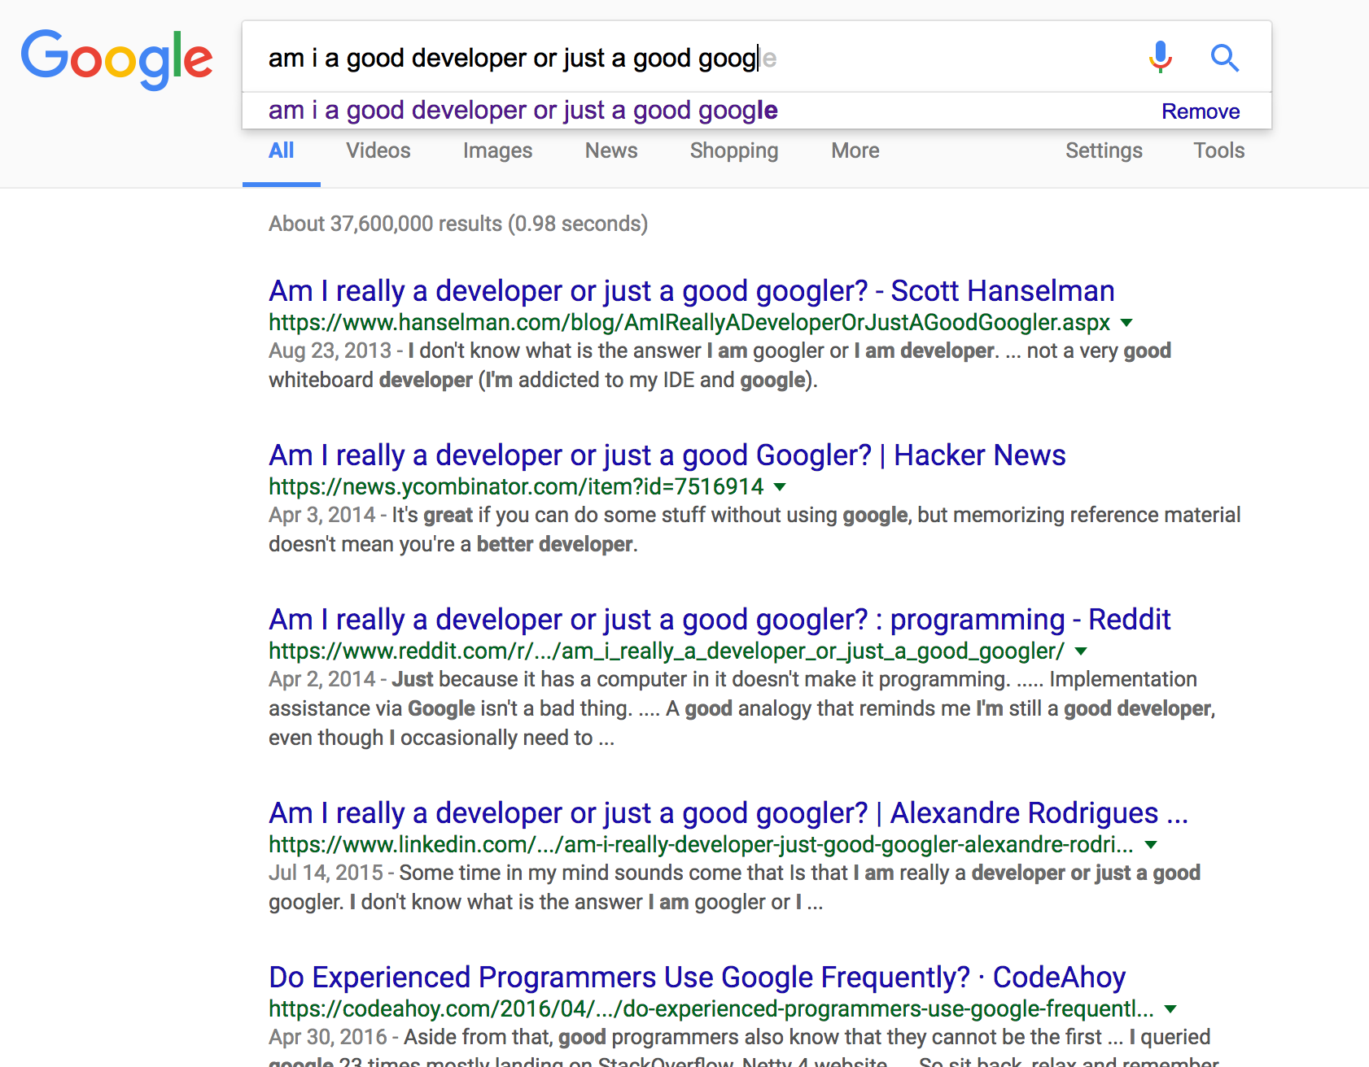
Realize Engage Treat Reread Accept Identify Never
Accept that odd truth that nobody around you really knows what they’re doing either.

Slide 13
Realize Engage Treat Reread Accept Identify Never
Identify that perfectionism stems from black and white thinking.

Slide 14
Realize Engage Treat Reread Accept Identify Never
Never run away from your fears. You may miss out on cool opportunities!
Notes:
AMAZON !!

Slide 15
Realize Engage Treat Reread Accept Identify Never
Now you too can RETRAIN
your brain to overcome self-doubt!

Slide 16
Thank you! Now go forth and conquer...

